Slide 1

Department of BES-II
Basic Electrical and Electronic Circuits
23EC1203
Topic:
THEVENIN’S and Norton's THEOREM
Session – No. 04

Slide 2



AIM OF THE SESSION
To familiarize students with the basic concept of Thevenin’s Theorem
INSTRUCTIONAL OBJECTIVES
This Session is designed to:
Demonstrate the need for Thevenin’s and northons theorem
Describe the definition of Thevenin’s theorem
Analyze the procedure for finding Thevenin’s equivalent voltage (V_{Th}) and resistance (R_{Th})
Compare the thevinins and northons equivalent circuits
LEARNING OUTCOMES
At the end of this session, you should be able to:
Describe Thevenin’s theorem and Northons theorem.
Describe the role of Thevenin’s theorem in solving circuits with independent and dependent sources
Summarize Thevenin’s theorem and northons theorem

Slide 3
Thevenin’s theorem
It often occurs in practice that a particular element in a circuit is variable (usually called the load) while other elements are fixed.
For example, a household outlet terminal may be connected to different appliances constituting a variable load.
Each time the variable element is changed, the entire circuit has to be analyzed all over again.
To avoid this problem, Thevenin’s theorem provides a technique by which the fixed part of the circuit is replaced by an equivalent circuit.

Slide 4
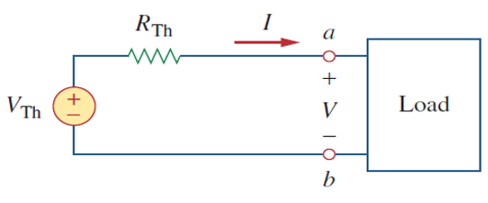
THEVENIN’S THEOREM
Definition
Thevenin’s theorem states that a linear two-terminal circuit can be replaced by an equivalent circuit consisting of a voltage source V_{Th} in series with a resistor R_{Th}, where V_{Th} is the open-circuit voltage at the terminals and R_{Th} is the input or equivalent resistance at the terminals when the independent sources are turned off.
Figure 2 Thevenin’s equivalent circuit

Slide 5
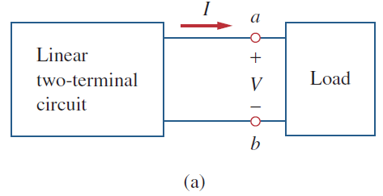
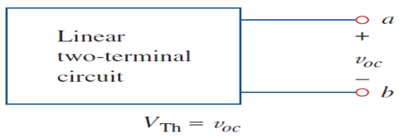
THEVENIN’S THEOREM(PROCEDURE)
Open the load resistor.
Calculate the open circuit voltage.This is the Thevenin Voltage (V_{TH}).
Open current sources and short voltage sources.
Calculate the Open Circuit Resistance. This is the Thevenin Resistance (R_{TH}).
Now, redraw the circuit with measured open circuit Voltage (V_{TH}) in Step (2) as voltage source and measured open circuit resistance (R_{TH}) in step (4) as a series resistance and connect the load resistor which we had removed in Step (1). This is the equivalent Thevenin circuit of that linear electric network.
Now find the Total current flowing through the load resistor by using the Ohm’s Law: I_{T} = V_{TH} / (R_{TH} + R_{L}).
(b)
Figure 3 Finding V_{Th} .

Slide 6
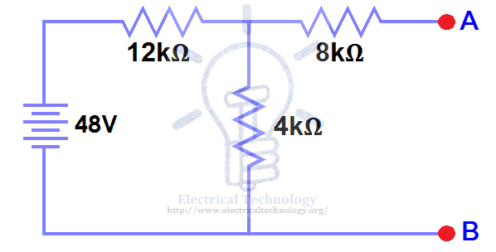
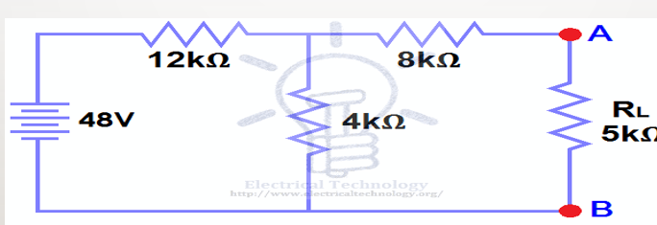
Problems on Thevenin’s theorem
Find the current flowing through 5K Resistor using
Thevenin's Theorem.
STEP 1.
Open the 5kΩ load resistor

Slide 7
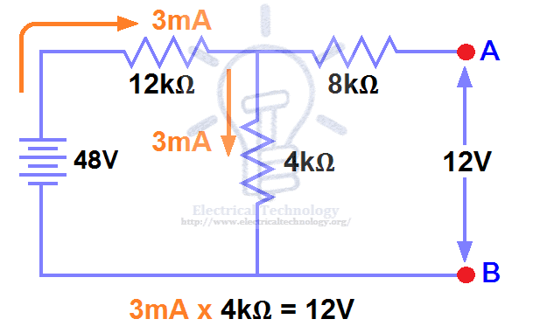
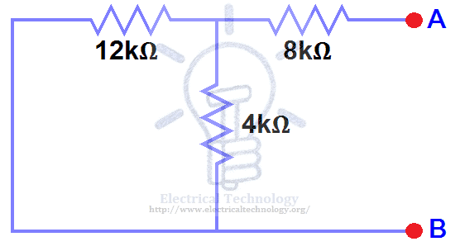
Problems on Thevenin’s theorem
Step 3.
Open current sources and short voltage sources as shown below.
STEP 2.
Calculate the open circuit voltage. This is the Thevenin Voltage (V_{TH}). Fig (3).
Now the circuit became an open circuit .Since 3mA
current flows in both 12kΩ and 4kΩ resistors as this is a series circuit and current will not flow in the 8kΩ resistor as it is open.

Slide 8
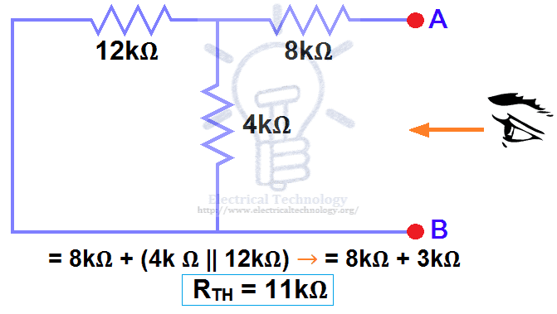
Problems on Thevenin’s theorem
Step 4:
Calculate the open circuit resistance. This is the Thevenin Resistance (R_{TH})
We have removed the 48V DC source to zero as equivalent i.e. short circuit. We can see that 8kΩ resistor is in series with a parallel connection of 4kΩ resistor and 12k Ω resistor. i.e.:
8kΩ + (4k Ω || 12kΩ) ….. (|| = in parallel with)
R_{TH} = 8kΩ + [(4kΩ x 12kΩ) / (4kΩ + 12kΩ)]
R_{TH} = 8kΩ + 3kΩ

Slide 9
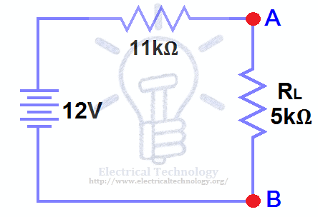
Problems on Thevenin’s theorem
STEP 5.
Connect the R_{TH} in series with Voltage Source V_{TH} and re-connect the load resistor. This is shown in fig (6) i.e. Thevenin circuit with load resistor. This the Thevenin’s equivalent circuit.
STEP 6.
Now apply the last step i.e Ohm’s law .
Calculate the total load current and load voltage
I_{L} = V_{TH} / (R_{TH} + R_{L})
I_{L} = 12V / (11kΩ + 5kΩ) → = 12/16kΩ
I_{L} = 0.75mA
And V_{L} = I_{L} x R_{L}
V_{L} = 0.75mA x 5kΩ
V_{L}= 3.75V

Slide 10

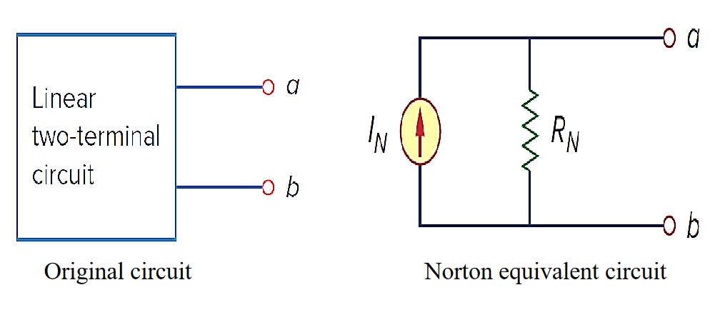
NORTHON’S THEOREM
Statement: A linear two-terminal circuit can be replaced by an equivalent circuit consisting of a current source I_{N} in parallel with a resistor R_{N} , where I_{N} is the short-circuit current through the terminals and R_{N} is the input or equivalent resistance at the terminals when the independent sources are turned off.

Slide 11
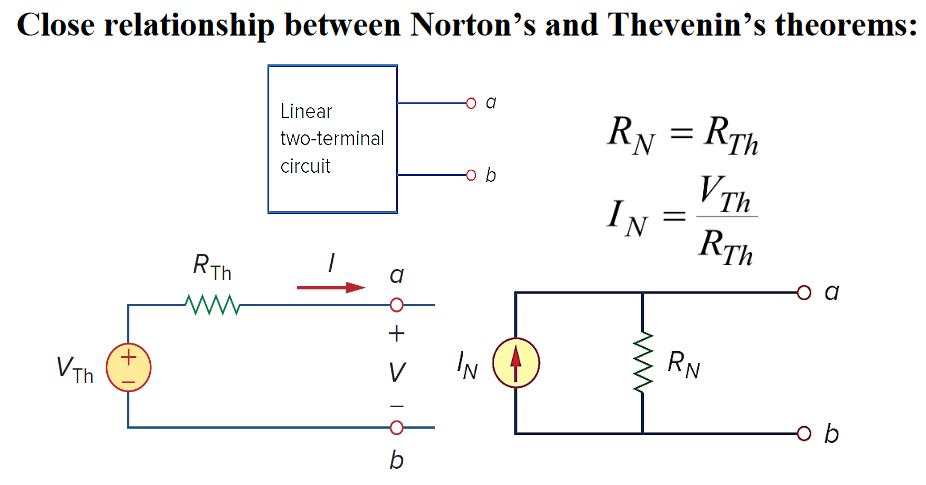
Relation between Nortons and Thevenins Theorem

Slide 12
Procedure
Norton’s theorem states that all linear circuits can be simplified to an equivalent circuit with a single current source in parallel with a single resistor connected to a load.
Step 1: Remove the load resistor and replace it with a short circuit.
Step 2: Calculate the Norton current—the current through the short circuit.
Step 3: Replace the power sources. All voltage sources are replaced with short circuits, and all current sources are replaced with open circuits.
Step 4: Calculate the Norton resistance—the total resistance between the open circuit connection points after all sources have been removed.
Step 5: Draw the Norton equivalent circuit, with the Norton current source in parallel with the Norton resistance. The load resistor re-attaches between the two open points of the equivalent circuit.

Slide 13
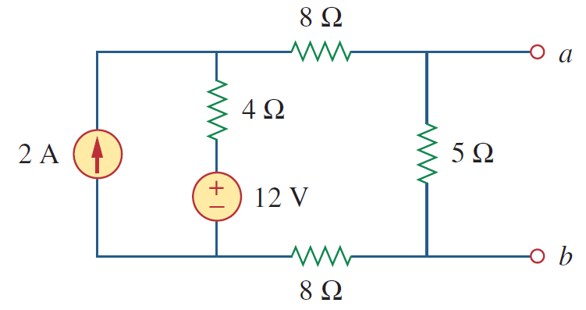
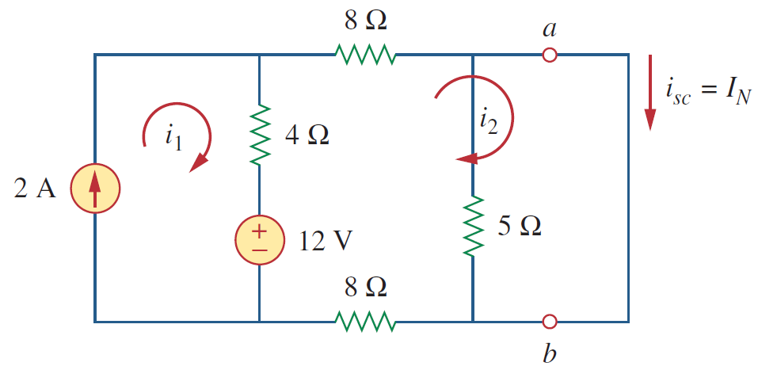
Problems on Northons Theorem
1.Find the Norton’s equivalent for the circuit shown below
Step1: find IN

Slide 14
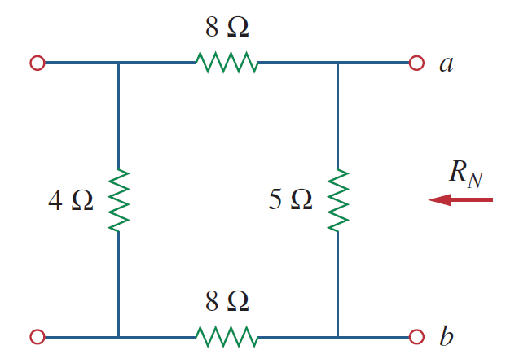
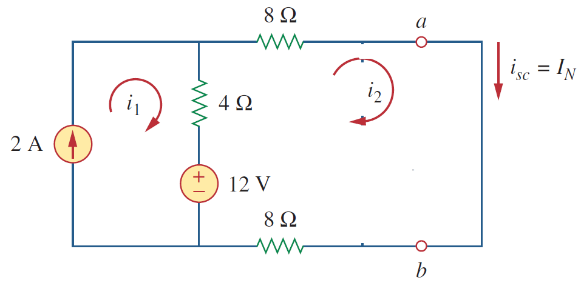

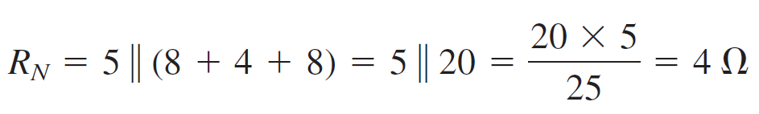
Problems on Northons Theorem
2.Northons equivalent Resistance
1. Northons current

Slide 15
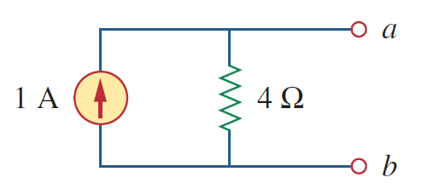
Problems on Northons Theorem

Slide 16
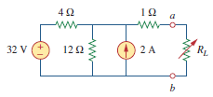
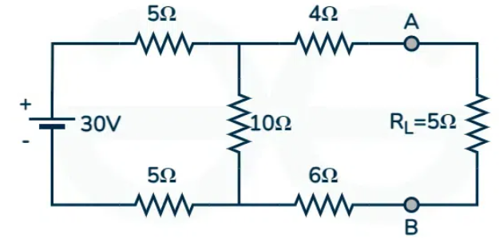
EXAMPLES
Example 1: Find the Thevenin equivalent circuit of the circuit shown in Fig. 7, to the left of the terminals a-b. Then find the current through R_{L} = 6,16, and 36 Ω. (With independent sources)
2. Find the value of current across the load branch in the given circuit using Norton's Theorem.
Figure 8 Finding R_{Th}

Slide 17
SELF-ASSESSMENT QUESTIONS
The Thevenin voltage is the__________
Open circuit voltage
Short circuit voltage
Open circuit and short circuit voltage
Neither open circuit nor short circuit voltage
Thevenin resistance is found by ________
Shorting all voltage sources
Opening all current sources
Shorting all voltage sources and opening all current sources
Opening all voltage sources and shorting all current sources

Slide 18
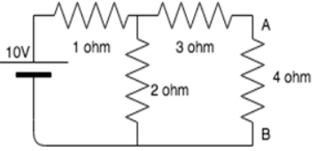
SELF-ASSESSMENT QUESTIONS
Calculate the Thevenin resistance and Thevenin voltage across the terminal AB for the following circuit.
4.34 ohm, 5.54V
3.67 ohm, 6.67V
3.43 ohm, 3.67V
2.32 ohm, 3.33V
Calculate the current across the 4 ohm resistor..
0.86 A
1.23 A
2.22 A
0.67A

Slide 19
TERMINAL QUESTIONS
Describe the definition of Thevenin’s Theorem with examples?
Describe the NORTON’s Theorem.
Analyze the working of an electrical circuitary using Norton theorem.
2. List out the procedure for finding Thevenin’s voltage and Thevenin’s resistance?
3. Analyze any circuit containing both dependent and independent sources to find Thevenin’s voltage and Thevenin’s resistance?
4. Summarize the usefulness of thevenin’s theorem with an examples?

Slide 20
REFERENCES FOR FURTHER LEARNING OF THE SESSION
Reference Books:
1. Alexander, Charles K., Sadiku, Matthew N.O.. (2013). Fundamentals of electric circuits (5th ed). New York: McGraw-Hill.
2. M. E. Van Valkenburg, Network Analysis 3rd Edition, Pearson Education
Sites and Web links:
1. https://archive.nptel.ac.in/courses/108/105/108105159/
2. https://resources.pcb.cadence.com/blog/2023-the-basic-laws-and-theorems-in-electrical-circuit-network-analysis

Slide 21
THANK YOU
Team – BEC

